Slide 1
Vehicle Counting
ICRL-1001-22

Slide 2
Problem Statement
Research Methodology
Result
Outline

Slide 3
Problem Statement
1.

Slide 4
Introduction
The aim of this project is to analyze the vehicle analytics in the parking area of an office or institute.
We were analyzing the quantity of vehicles enter or exit from the parking area.
We are classifying the type of vehicle either it is car, bus truck van or motor bike.

Slide 5
Research Focus
Find robust deep learning based model for detection for vehicle count and classification of the vehicle as car, bus, truck, van and motor bike in parking.

Slide 6
RESEARCH METHODOLOGY
2.

Slide 7
Research Methodology
Dataset
Preprocessing Step
Train Test Split
Training Phase
Evaluation Phase
Research
Methodology

Slide 8
Dataset
Parking area recorded videos
Video Length: 2-3 minutes
Video Quantity: 10-12 clips

Slide 9
Preprocessing
Extract Image Frames from Videos
Annotate the Extracted Image Frame
Annotation Criteria
Car
Bus
Truck
Van
Motor bike

Slide 10
Train Test Split
Split Dataset into training and Testing Set
Split data with 70 and 30 ratio.
Samples in Training and Testing Set.
Training Set (n=2500)
Testing Set (n=300)

Slide 11
Training Phase
Use Training Set for the training of the models.
Train the Following Machine Learning models:
Faster R CNN
Use the testing set for the evaluation of the train models.

Slide 12
Evaluation Measures
Evaluation Measures
1. Mean Absolute Error (MAE)
2. Mean Squared Error (MSE)
3. Root Mean Squared Error (RMSE)

Slide 13
Results
3.

Slide 14
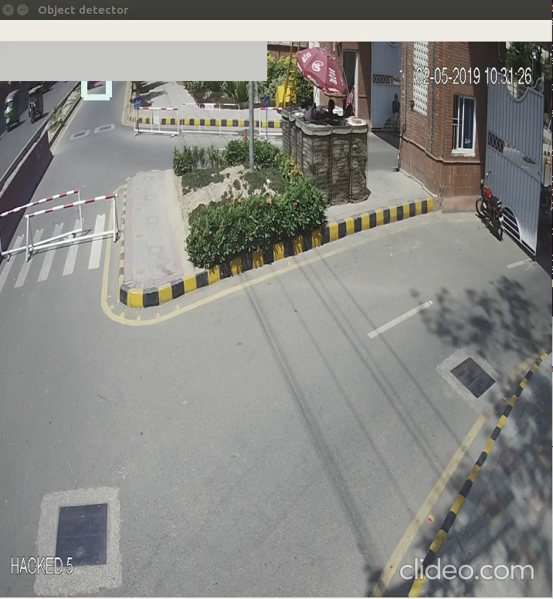
Model Results

Slide 15
Thank You

